Slide 1
Blockchain Technology
Revolutionizing Data Security and Transparency
Konda Charana
22071A6788

Slide 2
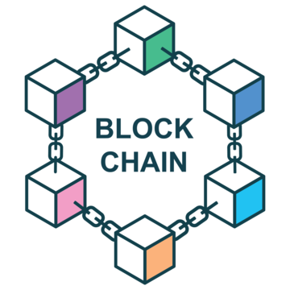
What is Blockchain?
A decentralized, distributed ledger that records transactions across many computers
Key Characteristics:
Data stored in “blocks” and chained together
Secure and transparent
Immutable (cannot be altered once added)

Slide 3
How Does Blockchain Work?
Process Overview:
Transaction Initiation: A transaction is requested
Verification: The network of nodes verifies the transaction using algorithms
Block Creation: Once verified, the transaction is added to a new block
Block Added to the Chain: The block is added to the blockchain in chronological order
Completion: The transaction is completed
Security: Secured using cryptography

Slide 4
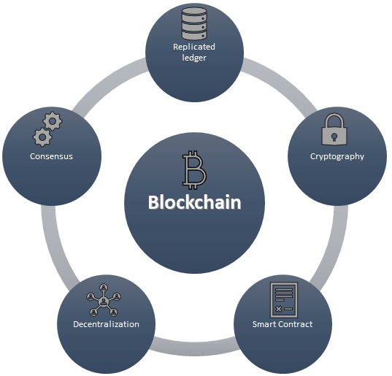
Key Features of Blockchain
Decentralization: No central authority controlling the data
Transparency: All participants can view the transactions
Immutability: Once data is written, it cannot be changed
Security: Data is encrypted and verified by the network

Slide 5
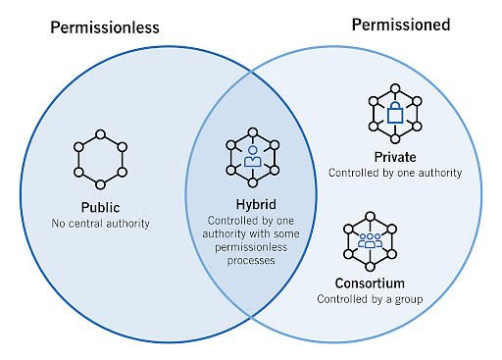
Types of Blockchain
Public Blockchain:
Open to everyone (e.g., Bitcoin, Ethereum)
Private Blockchain:
Permissioned, controlled by a specific organization
Consortium Blockchain:
Controlled by a group of organizations (e.g., banking consortia)
Hybrid Blockchain:
Combination of public and private elements

Slide 6
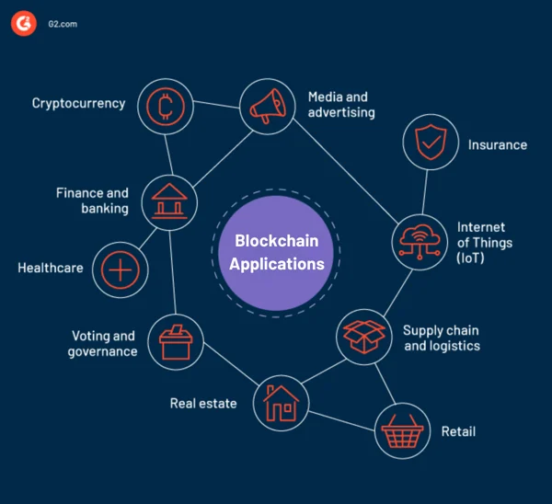
Applications of Blockchain
Cryptocurrency: Bitcoin, Ethereum, and other digital currencies
Supply Chain Management: Ensuring product traceability
Smart Contracts: Self-executing contracts with rules and agreements directly written into code
Healthcare: Secure and decentralized medical records
Voting Systems: Transparent and tamper-proof election processes

Slide 7
Advantages of Blockchain
Enhanced Security: Encryption and decentralization make it highly secure
Reduced Costs: Eliminates the need for intermediaries
Increased Transparency: All transactions are visible and auditable
Improved Traceability: Every transaction is permanently recorded

Slide 8
Challenges of Blockchain
Scalability Issues: Processing speed can be slow with large volumes
Energy Consumption: Mining and validating transactions require significant energy
Regulatory Concerns: Legal frameworks are still developing
Adoption Barriers: Many industries are slow to adopt due to unfamiliarity

Slide 9
The Future of Blockchain
Growth in Adoption: Increasing use in various industries (finance, healthcare, logistics)
Integration with Emerging Technologies: Combining with IoT, AI, and big data
Scalability Solutions: Advancements in technology to increase blockchain efficiency
Rise of Decentralized Finance (DeFi): Financial systems built on blockchain without traditional banks

Slide 10
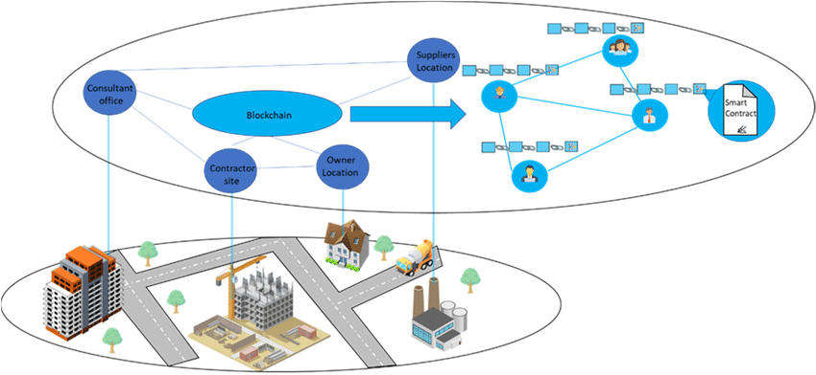
The future vision for blockchain technology with the integration of IoT in the construction industry.

Slide 11
Conclusion
Summary: Blockchain is a transformative technology that enhances security, transparency, and efficiency across many industries.
Future Potential: With continuous improvements, blockchain could revolutionize sectors from finance to healthcare.

